Slide 1
Software Project Management
Project Evaluation and programme management

Slide 2
Introduction
ICT – Information and Communications Technology
ICT projects – analyze the significance
  Evaluate benefits of a project
  Selection of the projects

Slide 3
Business case
Feasibility study or project justification
Business case document contains
  Introduction and background to the proposal
  The proposed project
  The market
  Organizational and operational infrastructure
  The benefits

Slide 4
Business case
Feasibility study or project justification
Business case document contains
  Outline implementation plan
  Costs
  The financial case
  Risks
  Management plan

Slide 5
Project portfolio management
Overview of all the projects
Prioritizes allocation of resources
Decides which projects to accept and to drop

Slide 6
Project portfolio management
Concerns
  Identifying project proposals to implement
  Assessing the amount of risk of failure
  Deciding how to share limited resources
  Being aware of the dependencies between projects
  Ensuring projects do not duplicate work
  Ensuring that necessary developments have not been missed

Slide 7
Project portfolio management
3 key aspects of project portfolio management:
  Project portfolio definition
  Project portfolio management
  Project portfolio optimization

Slide 8
Project portfolio management
Project portfolio definition
  Single repository for projects
  Repository for only ICT projects or others also
  Projects
    New Product Developments (NPD) – E.g. Game
    Renewal Projects – E.g. information Systems

Slide 9
Project portfolio management
Project portfolio management
  Details about costings of projects recorded
  Tracking
  Basis for the more rigorous screening of new projects

Slide 10
Project portfolio management
Project portfolio optimization
  Performance of the portfolio will be tracked
  May not be profitable – e-commerce site
  Moderate benefit – automating processes
Need thought-out balance between two types of projects

Slide 11
Project portfolio management
Problems with project portfolio management
  Allocation of full-time staff
  Projects that are over a level of cost will be recorded in the portfolio

Slide 12
Evaluation of individual projects
Technical assessment
Cost-benefit analysis
Cash flow forecasting

Slide 13
Evaluation of individual projects
Technical assessment
  Required functionality can be achieved with current affordable technologies
  Hardware/software
  Cost-benefit analysis

Slide 14
Evaluation of individual projects
Cost-benefit analysis
  Most valuable projects should get most resources
  2 steps
    Identifying all of the costs and benefits of carrying out the project and operating the delivered application
    Expressing these costs and benefits in common units

Slide 15
Evaluation of individual projects
Cost-benefit analysis
  Direct cost
    Development cost
    Setup cost
    Operational cost

Slide 16
Evaluation of individual projects
Cash flow forecasting
  When expenditure and income takes place
  E.g. salary, income

Slide 17
Cost-benefit evaluation techniques
Year | Project 1 | Project 2 | Project 3 | Project 4
0 | -1,00,000 | -10,00,000 | -1,00,000 | -1,20,000
1 | 10,000 | 2,00,000 | 30,000 | 30,0000
2 | 10,000 | 2,00,000 | 30,000 | 30,0000
3 | 10,000 | 2,00,000 | 30,000 | 30,0000
4 | 20,000 | 2,00,000 | 30,000 | 30,0000
5 | 1,00,000 | 3,00,000 | 30,000 | 75,000
Net profit | 50,000 | 1,00,000 | 50,000 | 75,000

Slide 18
Net Profit
Difference between the total costs and the total income over the life of the project
‘Year 0’ represents all the costs before system is operation
‘Cash-flow’ is value of income minus outgoing
Net profit value of all the cash-flows for the lifetime of the application
Year | Cash-flow
0 | -100,000
1 | 10,000
2 | 10,000
3 | 10,000
4 | 20,000
5 | 100,000
Net profit | 50,000

Slide 19
Net Profit
Project 2 Net profit is higher – but investment also higher
Project 1 and 3 – equal
Income

Slide 20
Payback period
Time taken to break even or pay back the initial investment
This is the time it takes to start generating a surplus of income over outgoings. What would it be below?
Year | Cash-flow | Accumulated
0 | -100,000 | -100,000
1 | 10,000 | -90,000
2 | 10,000
3 | 10,000
4 | 20,000
5 | 100,000

Slide 21
Payback period
Time taken to break even or pay back the initial investment
This is the time it takes to start generating a surplus of income over outgoings. What would it be below?
Year | Cash-flow | Accumulated
0 | -100,000 | -100,000
1 | 10,000 | -90,000
2 | 10,000 | -80,000
3 | 10,000
4 | 20,000
5 | 100,000

Slide 22
Payback period
Time taken to break even or pay back the initial investment
This is the time it takes to start generating a surplus of income over outgoings. What would it be below?
Year | Cash-flow | Accumulated
0 | -100,000 | -100,000
1 | 10,000 | -90,000
2 | 10,000 | -80,000
3 | 10,000 | -70,000
4 | 20,000
5 | 100,000

Slide 23
Payback period
Time taken to break even or pay back the initial investment
This is the time it takes to start generating a surplus of income over outgoings. What would it be below?
Year | Cash-flow | Accumulated
0 | -100,000 | -100,000
1 | 10,000 | -90,000
2 | 10,000 | -80,000
3 | 10,000 | -70,000
4 | 20,000 | -50,000
5 | 100,000

Slide 24
Payback period
Time taken to break even or pay back the initial investment
This is the time it takes to start generating a surplus of income over outgoings. What would it be below?
Year | Cash-flow | Accumulated
0 | -100,000 | -100,000
1 | 10,000 | -90,000
2 | 10,000 | -80,000
3 | 10,000 | -70,000
4 | 20,000 | -50,000
5 | 100,000 | 50,000

Slide 25
Cost-benefit evaluation techniques
Year | Project 1 | Project 2 | Project 3 | Project 4
0 | -1,00,000 | -10,00,000 | -1,00,000 | -1,20,000
1 | 10,000 | 2,00,000 | 30,000 | 30,0000
2 | 10,000 | 2,00,000 | 30,000 | 30,0000
3 | 10,000 | 2,00,000 | 30,000 | 30,0000
4 | 20,000 | 2,00,000 | 30,000 | 30,0000
5 | 1,00,000 | 3,00,000 | 30,000 | 75,000
Net profit | 50,000 | 1,00,000 | 50,000 | 75,000

Slide 26
Payback period
Project 2, 3, 4
Year | Cash-flow | Accumulated
0 | -10,00,000 | -10,00,000
1 | 2,00,000 | -8,00,000
2 | 2,00,000 | -6,00,000
3 | 2,00,000 | -4,00,000
4 | 2,00,000 | -2,00,000
5 | 3,00,000 | 1,00,000
Year | Cash-flow | Accumulated
0 | -1,00,000 | -1,00,000
1 | 30,000 | -70,000
2 | 30,000 | -40,000
3 | 30,000 | -10,000
4 | 30,000 | 20,000
5 | 30,000 | 50,000
Year | Cash-flow | Accumulated
0 | -1,20,000 | -1,20,000
1 | 30,0000 | -90,000
2 | 30,0000 | -60,000
3 | 30,0000 | -30,000
4 | 30,0000 | 0
5 | 75,000 | 75,000

Slide 27
Payback period
Advantage:
  Simple to calculate
  Not particularly sensitive to small forecasting errors
Disadvantage
  It ignores overall profitability, totally ignores any income (expenditure)

Slide 28
Return on investment (ROI)
ROI =
Average annual profit
Total investment
X 100
In the previous example (Project 1 and 3)
Investment – 1,00,000, Net Profit – 50,000
average annual profit
= 50,000/5
=10,000
ROI = 10,000/ 1,00,000X 100 = 10%
Notes:
Exercise 3.4. gives further practice is calculating ROI.

Slide 29
Return on investment (ROI)
ROI =
Average annual profit
Total investment
X 100
In the previous example (Project 2)
Investment – 10,00,000, Net Profit – 1,00,000
average annual profit
= 1,00,000/5
= 20,000
ROI = 20,000/10,00,000 X 100 = 2%
Notes:
Exercise 3.4. gives further practice is calculating ROI.

Slide 30
Return on investment (ROI)
ROI =
Average annual profit
Total investment
X 100
In the previous example (Project 4)
Investment – 1,20,000, Net Profit – 75,000
average annual profit
= 75,000/5
= 15,000
ROI = 15,000/1,20,000 X 100 = 12.5 %
Notes:
Exercise 3.4. gives further practice is calculating ROI.

Slide 31
Net present value
Would you rather I gave you $100 today or in 12 months time?
If I gave you $100 now you could put it in savings account and get interest on it.
If the interest rate was 10% how much would I have to invest now to get $100 in a year’s time?
This figure is the net present value of $100 in one year’s time
Notes:
If you invested £91 now you would get £9.10 in interest which would give you £100.10 in 12 months

Slide 32
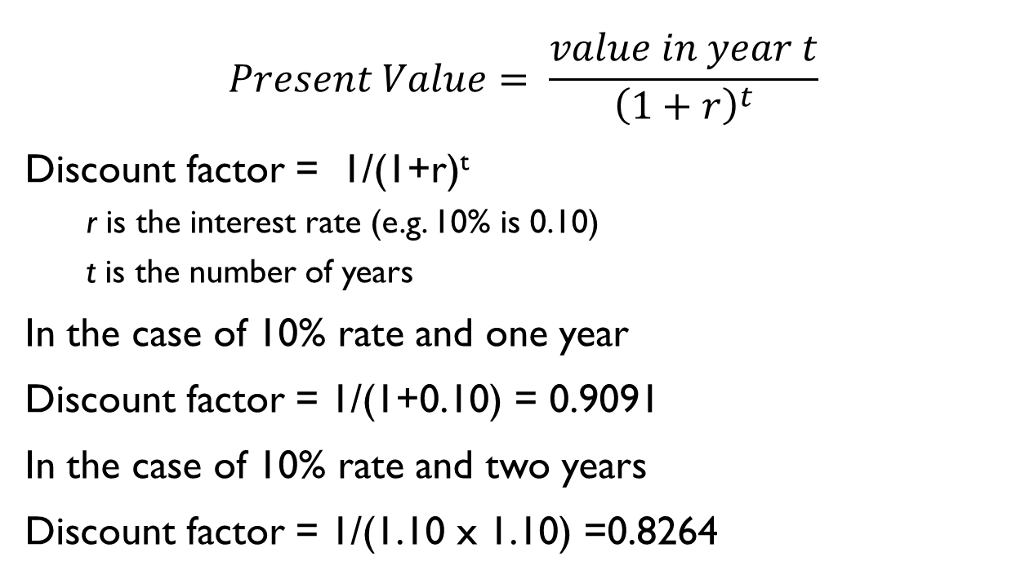
Discount factor
$$Present Value= \frac{value in year t}{{\left(1+r\right)}^{t}}$$
Discount factor = 1/(1+r)^{t}
  r is the interest rate (e.g. 10% is 0.10)
  t is the number of years
In the case of 10% rate and one year
Discount factor = 1/(1+0.10) = 0.9091
In the case of 10% rate and two years
Discount factor = 1/(1.10 x 1.10) =0.8264

Slide 33
Discount factor
Applying the discount factor to Project 1
10% rate and 1 year
Discount factor = 1/(1+0.10) = 0.9091
Discounted cash flow = 0.9091 x 10,000
= $9091
2nd Year
Discount factor = 1/(1.10 x 1.10) = 1/1.21
= 0.8264
Discounted cash flow = 0.8264 x 10000
= $8264

Slide 34
Discount factor
Applying the discount factor to Project 1
3rd Year
Discount factor = 1/(1+0.10)³= 1/(1.10)³
= 1/1.331 = 0.7513
Discounted cash flow = 0.7513 x 10,000
= $7513
4th Year
Discount factor = 1/(1.10)⁴ = 1/1.4641
= 0.6830
Discounted cash flow = 0.6830 x 20000
= $13660

Slide 35
Discount factor
Applying the discount factor to Project 1
5th Year
Discount factor = 1/(1+0.10)5= 1/(1.10)⁵
= 1/1.6105 = 0.6209
Discounted cash flow = 0.6209 x 1,00,000
= $62090

Slide 36
Applying discount factors
Year | Cash-flow | Discount factor | Discounted cash flow
0 | -100,000 | 1.0000 | -100,000
1 | 10,000 | 0.9091 | 9,091
2 | 10,000 | 0.8264 | 8,264
3 | 10,000 | 0.7513 | 7,513
4 | 20,000 | 0.6830 | 13,660
5 | 100,000 | 0.6209 | 62,090
 |  | NPV | 618
Notes:
NPV is the sum of the discounted cash flows for all the years of the ‘project’ (note that in NPV terms the lifetime of the completed application is included in the ‘project’)
The figure of £618 means that £618 more would be made than if the money were simply invested at 10%. An NPV of £0 would be the same amount of profit would be generated as investing at 10%.

Slide 37
Net present value
Project 2
Year | Cash-flow | Discount Factor | Discounted cash flow
0 | -10,00,000 | 1.0000
1 | 2,00,000 | 0.9091
2 | 2,00,000 | 0.8264
3 | 2,00,000 | 0.7513
4 | 2,00,000 | 0.6830
5 | 3,00,000 | 0.6209

Slide 38
Net present value
Project 2
Year | Cash-flow | Discount Factor | Discounted cash flow
0 | -10,00,000 | 1.0000 | -10,00,000
1 | 2,00,000 | 0.9091 | 1,81,820
2 | 2,00,000 | 0.8264 | 1,65,280
3 | 2,00,000 | 0.7513 | 1,50,260
4 | 2,00,000 | 0.6830 | 1,36,600
5 | 3,00,000 | 0.6209 | 1,86,270
 |  | NPV | -1,79,770

Slide 39
Net present value
Project 3
Year | Cash-flow | Discount Factor | Discounted cash flow
0 | -1,00,000 | 1.0000
1 | 30,000 | 0.9091
2 | 30,000 | 0.8264
3 | 30,000 | 0.7513
4 | 30,000 | 0.6830
5 | 30,000 | 0.6209
 |  | NPV

Slide 40
Net present value
Project 3
Year | Cash-flow | Discount Factor | Discounted cash flow
0 | -1,00,000 | 1.0000 | -100000
1 | 30,000 | 0.9091 | 27273
2 | 30,000 | 0.8264 | 24792
3 | 30,000 | 0.7513 | 22539
4 | 30,000 | 0.6830 | 20490
5 | 30,000 | 0.6209 | 18627
 |  | NPV | 13721

Slide 41
Net present value
Project 4
Year | Cash-flow | Discount Factor | Discounted cash flow
0 | -1,20,000 | 1.0000
1 | 30,000 | 0.9091
2 | 30,000 | 0.8264
3 | 30,000 | 0.7513
4 | 30,000 | 0.6830
5 | 75,000 | 0.6209
 |  | NPV

Slide 42
Net present value
Project 4
Year | Cash-flow | Discount Factor | Discounted cash flow
0 | -1,20,000 | 1.0000 | -120000
1 | 30,000 | 0.9091 | 27273
2 | 30,000 | 0.8264 | 24792
3 | 30,000 | 0.7513 | 22539
4 | 30,000 | 0.6830 | 20490
5 | 75,000 | 0.6209 | 46568
 |  | NPV | 21662

Slide 43
Net present value
Project 4 provides the greatest return
Project 2 is not worth considering
Project 1 and 3 are significantly different – even though they yield the same net profit and both have the same return on investment

Slide 44
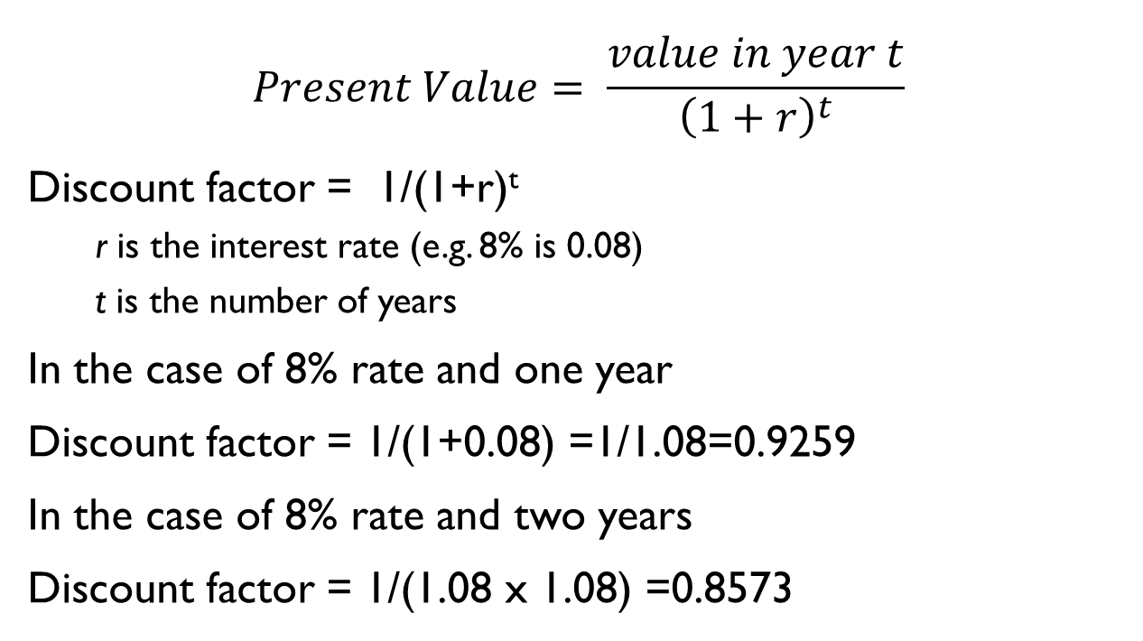
Discount factor
$$Present Value= \frac{value in year t}{{\left(1+r\right)}^{t}}$$
Discount factor = 1/(1+r)^{t}
  r is the interest rate (e.g. 8% is 0.08)
  t is the number of years
In the case of 8% rate and one year
Discount factor = 1/(1+0.08) =1/1.08=0.9259
In the case of 8% rate and two years
Discount factor = 1/(1.08 x 1.08) =0.8573

Slide 45
Discount factor
Applying the discount factor to Project 1
10% rate and 1 year
Discount factor = 1/(1+0.10) = 0.9091
Discounted cash flow = 0.9091 x 10,000
= $9091
2nd Year
Discount factor = 1/(1.10 x 1.10) = 1/1.21
= 0.8264
Discounted cash flow = 0.8264 x 10000
= $8264

Slide 46
Discount factor
Applying the discount factor to Project 1
3rd Year
Discount factor = 1/(1+0.08)³= 1/(1.08)³
= 1/1.259712 = 0.7938
Discounted cash flow = 0.7513 x 10,000
= $7513
4th Year
Discount factor = 1/(1.08)⁴ = 1/1.360 = 0.735 = 0.6830
Discounted cash flow = 0.6830 x 20000
= $13660

Slide 47
Discount factor
Applying the discount factor to Project 1
5th Year
Discount factor = 1/(1+0.08)5= 1/(1.08)⁵
= 1/1.4693 = 0.6806
Discounted cash flow = 0.6209 x 1,00,000
= $62090

Slide 48
Applying discount factors
Year | Cash-flow | Discount factor | Discounted cash flow
0 | -100,000 | 1.0000 | -100,000
1 | 10,000 | 0.9259 | 9259
2 | 10,000 | 0.8573 | 8573
3 | 10,000 | 0.7938 | 7938
4 | 20,000 | 0.7350 | 14700
5 | 100,000 | 0.6806 | 68060
 |  | NPV | 8530
Notes:
NPV is the sum of the discounted cash flows for all the years of the ‘project’ (note that in NPV terms the lifetime of the completed application is included in the ‘project’)
The figure of £618 means that £618 more would be made than if the money were simply invested at 10%. An NPV of £0 would be the same amount of profit would be generated as investing at 10%.

Slide 49
Net present value
Project 2
Year | Cash-flow | Discount Factor | Discounted cash flow
0 | -10,00,000 | 1.0000
1 | 2,00,000 | 0.9091
2 | 2,00,000 | 0.8264
3 | 2,00,000 | 0.7513
4 | 2,00,000 | 0.6830
5 | 3,00,000 | 0.6209

Slide 50
Net present value
Project 2
Year | Cash-flow | Discount Factor | Discounted cash flow
0 | -10,00,000 | 1.0000 | -10,00,000
1 | 2,00,000 | 0.9091 | 1,81,820
2 | 2,00,000 | 0.8264 | 1,65,280
3 | 2,00,000 | 0.7513 | 1,50,260
4 | 2,00,000 | 0.6830 | 1,36,600
5 | 3,00,000 | 0.6209 | 1,86,270
 |  | NPV | -1,79,770

Slide 51
Net present value
Project 3
Year | Cash-flow | Discount Factor | Discounted cash flow
0 | -1,00,000 | 1.0000
1 | 30,000 | 0.9091
2 | 30,000 | 0.8264
3 | 30,000 | 0.7513
4 | 30,000 | 0.6830
5 | 30,000 | 0.6209
 |  | NPV

Slide 52
Net present value
Project 3
Year | Cash-flow | Discount Factor | Discounted cash flow
0 | -1,00,000 | 1.0000 | -100000
1 | 30,000 | 0.9091 | 27273
2 | 30,000 | 0.8264 | 24792
3 | 30,000 | 0.7513 | 22539
4 | 30,000 | 0.6830 | 20490
5 | 30,000 | 0.6209 | 18627
 |  | NPV | 13721

Slide 53
Net present value
Project 4
Year | Cash-flow | Discount Factor | Discounted cash flow
0 | -1,20,000 | 1.0000
1 | 30,000 | 0.9091
2 | 30,000 | 0.8264
3 | 30,000 | 0.7513
4 | 30,000 | 0.6830
5 | 75,000 | 0.6209
 |  | NPV

Slide 54
Net present value
Project 4
Year | Cash-flow | Discount Factor | Discounted cash flow
0 | -1,20,000 | 1.0000 | -120000
1 | 30,000 | 0.9091 | 27273
2 | 30,000 | 0.8264 | 24792
3 | 30,000 | 0.7513 | 22539
4 | 30,000 | 0.6830 | 20490
5 | 75,000 | 0.6209 | 46568
 |  | NPV | 21662

Slide 55
Risk evaluation
Project risks, which prevent the project from being completed successfully, are different from the business risk that the delivered products are not profitable.

Slide 56
Risk identification and ranking
Project risk matrix
  Checklist of possible risks and classifying risks according to their relative importance and likelihood

Slide 57
Risk identification and ranking
Risk | Importance | Liklihood
Client rejects proposed look and feel of site | H | _
Competitors undercut prices | H | M
Warehouse unable to deal with increased demand | M | L
Online payment has security problems | M | M
Maintenance costs higher than estimated | L | L
Response times deter purchasers | M | M
Project risk matrix
  H – High
  M – Medium
  L – Low
  _ - exceedingly
  unlikely

Slide 58
Risk and net present value
Project is relatively risky – use a higher discount rate to calculate net present value
  An additional 2% for reasonably safe project
  5% for fairly risky one
Categorized using scoring method – low, medium, high

Slide 59
Cost-benefit analysis – Another approach
Consider each possible outcome
Estimate the probability of its occurring and the corresponding value of the outcome
Calculate set of cash flow forecasts, each with an associated probability of occurring
Sum the cost or benefit for each possible outcome weighted by its corresponding probability.

Slide 60
Cost-benefit analysis
BuyRight, a software house, is considering developing a payroll application for use in academic institutions and is currently engaged in a cost-benefit analysis.
Study of the market has shown that, if they can target it efficiently and no competing products become available, they will obtain a high level of sales generating an annual income of Rs. 800,000. They estimate that there is a 1 in 10 chance of this happening.
However, a competitor might launch a competing application before their own launch date and then sales might generate only Rs. 100,000 per year.
They estimate that there is a 30% chance of this happening.
The most likely outcome, they believe, is somewhere in between these two extremes - they will gain a market lead by launching before any competing product becomes available and achieve an annual income of Rs. 650,000. BuyRight have therefore calculated their expected sales income as given in the following slide.

Slide 61
8,00,000 10% 0.1
1,00,000 30% 0.3
6,50,000 60% 1-(0.1+0.3)=1-0.4=0.6
1. expected income =8,00,000*0.1= 80,000
2. =1,00,000*0.3= 30,000
3. = 6,50,000*0.6=3,90,000
      5,00,000

Slide 62
BuyRight’s income forecasts
Sales | Annual Sales Income (Rs) i | Probability p | Expected value (Rs) i x p
High | 8,00,000 | 0.1 | 80,000
Medium | 6,50,000 | 0.6 | 3,90,000
Low | 1,00,000 | 0.3 | 30,000
Expected Income |  |  | 5,00,000

Slide 63
BuyRight’s income forecasts
Total development costs are estimated at Rs. 750,000 and sales are expected to be maintained at a reasonably constant level for at least four years. Annual costs of marketing and product maintenance are estimated at Rs. 200,000, irrespective of the market share gained. Would you advise them to go ahead with the project?
7,50,000 – once
Annual income = 5,00,000 – 2,00,000 = 3,00,000
For 4 years = 3,00,000*4= 12,00,000
Total income = 12,00,000 – 7,50,000 = 4,50,000

Slide 64
Risk profile analysis
An approach which attempts to overcome some of the objections to cost-benefit averaging is the construction of risk profiles using sensitivity analysis.
varying each of the parameters that affect the project's cost or benefits to ascertain how sensitive the project's profitability is to each factor.
Monte Carlo technique

Slide 65
Using decision trees
Evaluate whether a risk is important and if it is, decide a suitable course of action
Example:

Slide 66
Extending with Existing system or Replacing a new system
Business increases or not
Extending with Existing system & not increasing – NPV 75,000
Extending with existing system & business increases – NPV -1,00,000
Replacing a new system & market improves – NPV 2,50,000
Replacing a new system & market does not improve – NPV – 50,000
Prob. That market increases 20%
Prob that market does not improve 80%

Slide 67
-1,00,000
Increase 0.2
Expected value = 75000*0.8-1,00,000*0.2=40,000
Extend existing
75,000
No increase
0.8
D
2,50,000
Increase
0.2
Replace
Expected value = 2,50,000*0.2-50,000*0.8=10,000
-50,000
No increase
0.8

Slide 68
Programme management
One definition:
‘a group of projects that are managed in a co-ordinated way to gain benefits that would not be possible were the projects to be managed independently’ Ferns
Notes:
The quotation is from a paper that appeared in the International Journal of Project Management August 1991

Slide 69
Programmes may be
Strategic
Business cycle programmes
Infrastructure programmes
Research and development programmes
Innovative partnerships
Notes:
Strategic
Several projects together implement a single strategy. For example, merging two organizations will involve many different activities e.g. physical re-organization of offices, redesigning the corporate image, merging ICT systems etc. Each of these activities could be project within an overarching programme.
Business cycle programmes
A portfolio of project that are to take place within a certain time frame e.g. the next financial year
Infrastructure programmes
In an organization there may be many different ICT-based applications which share the same hardware/software infrastructure
Research and development programmes
In a very innovative environment where new products are being developed, a range of products could be developed some of which are very speculative and high-risk but potentially very profitable and some will have a lower risk but will return a lower profit. Getting the right balance would be key to the organization’s long term success
Innovative partnerships
e.g. pre-competitive co-operation to develop new technologies that could be exploited by a whole range of companies

Slide 70
Programme managers versus project managers
Programme manager
  Many simultaneous projects
  Personal relationship with skilled resources
  Optimization of resource use
  Projects tend to be seen as similar
Project manager
  One project at a time
  Impersonal relationship with resources
  Minimization of demand for resources
  Projects tend to be seen as unique
Notes:
The programme manager may well have a pool of staff upon which to call. He/she will be concerned with ensuring the best use of staff e.g ensuring that staff have regular work with no periods of enforced idleness between project tasks. The project leader would think in terms of ‘I need a Java programmer for four weeks’ without being concerned which specific person it is (beyond obvious concerns that they are fully capable).

Slide 71
Average profit/investment*100
Cost = 1,50,000
Average profit = 15000
ROI = 15000/1,50,000*100=1500/150=10%

